Slide 1
Advanced JavaScript

Slide 2
Contents
Event Bubbling and Capturing
Anonymous and Call-back functions
Closures
Function Overloading
OOPs in JavaScript
Prototype
Prototype Inheritance
Class in JavaScript
Module Pattern
Jquery
Jquery Widget Implementation
Jquery Plug-in Implementation
Jquery Plug-In Vs. Jquery Widget

Slide 3
Event Bubbling and Capturing
Event bubbling and capturing are two ways of event propagation in HTML DOM.
Event bubbling
In bubbling the event is first captured and handled by the inner most element and then propagated to outer elements.
Event Capturing
In capturing the event is first captured by the outer most element and propagated to the inner most element.

Slide 4
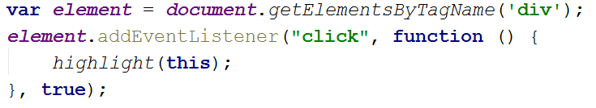
Event Bubbling and Capturing
How to bind events in Bubbling and Capturing phase.

Slide 5
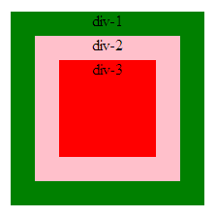
Event Bubbling and Capturing
Ex:

Slide 6
Event Bubbling and Capturing
Important Points
Only event bubbling model is supported by all the major browsers.
So if you are going to use event capturing still you need to handle event bubbling for IE. So it will easier to use event bubbling instead of capturing.

Slide 7
Anonymous and Call-backs functions
Anonymous Functions
Anonymous functions are functions that are dynamically declared at runtime.
These functions are not contain a name in the same way as normal functions.

Slide 8
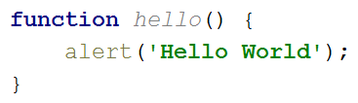
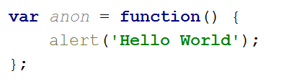
Anonymous and Call-backs functions
Normal function declaration
Anonymous function declaration

Slide 9
Anonymous and Call-backs functions
Callback Functions
Callback functions are the functions that are passed to another function as an argument.
Callback functions are probably the most widely used functional programming technique in JavaScript.

Slide 10
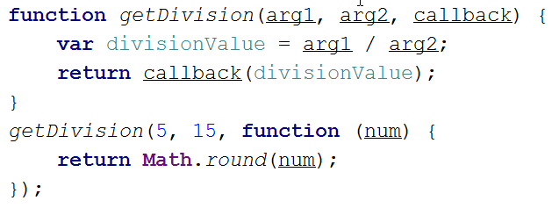
Anonymous and Call-backs functions
Ex1:

Slide 11
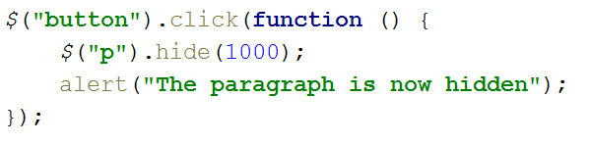
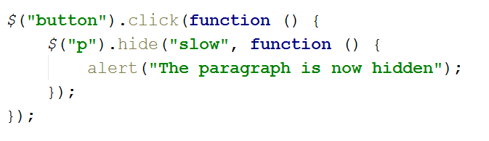
Anonymous and Call-backs functions
Ex2:
Ex3:

Slide 12
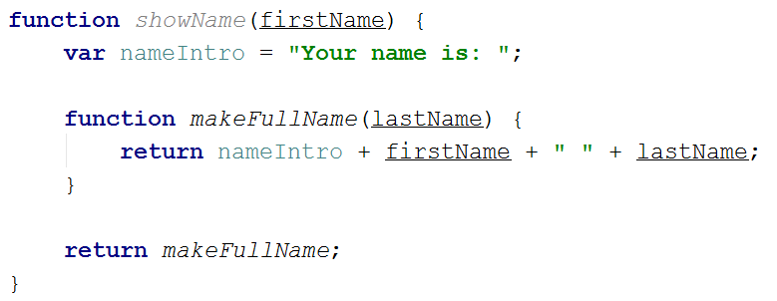
Closures
A closure is an inner function that has access to the outer (enclosing) function’s variables scope chain.
Ex1:

Slide 13
Function Overloading
Function or method overloading is declaring functions with the same name that accept different arguments thus have different behaviors depending on passed arguments.

Slide 14
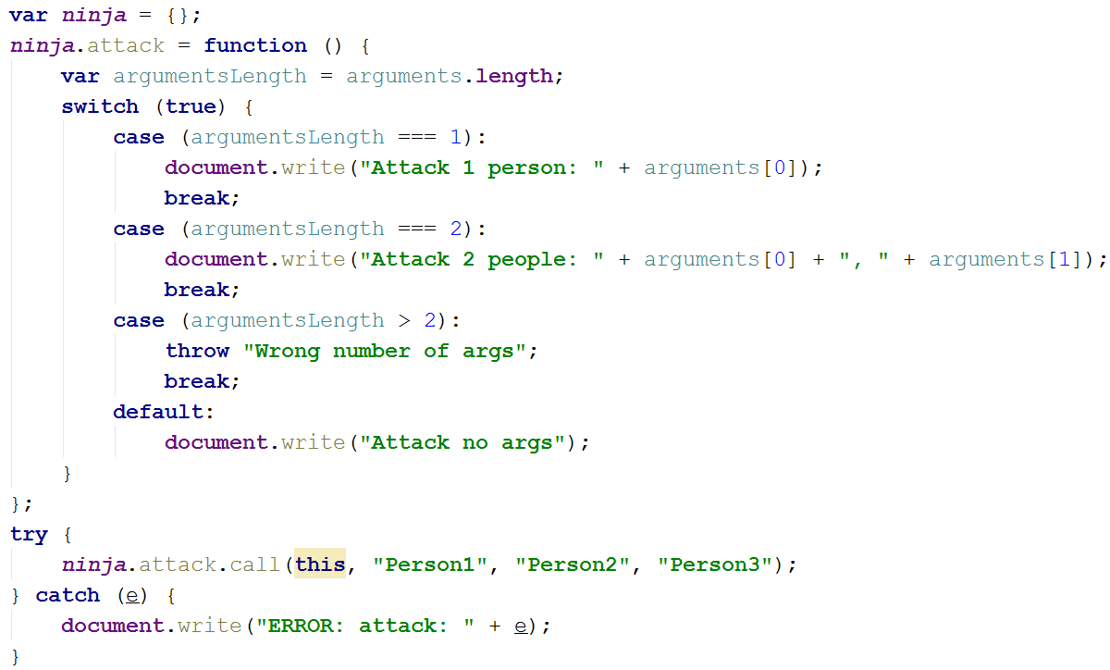
Function Overloading
Ex1:

Slide 15
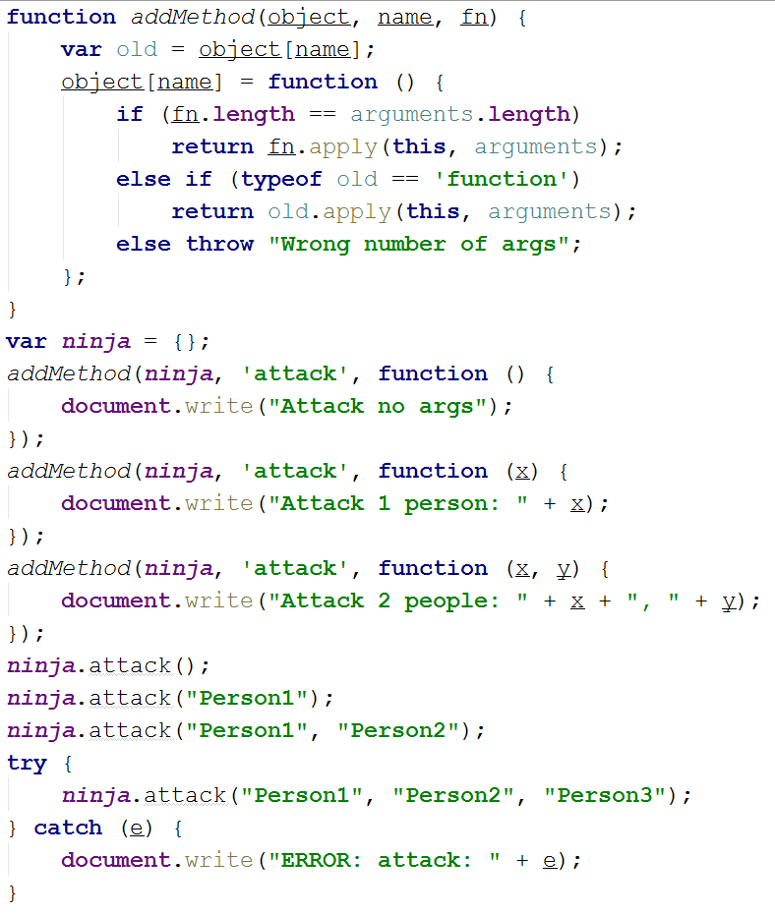
Function Overloading
Ex2:

Slide 16
OOPs in JavaScript
Object-oriented programming is intended to promote greater flexibility and maintainability in programming, and is widely popular in large-scale software engineering.
Concepts:
Class
Object
Property
Method
Constructor
Inheritance
Encapsulation
Abstraction
Polymorphism

Slide 17

OOPs in JavaScript
Class:
JavaScript is a prototype-based language which contains no class statement, such as is found in Php, C++ or Java.
Ex:

Slide 18
OOPs in JavaScript

Slide 19
OOPs in JavaScript

